Slide 1

1st Checkpoint : Web Fundamentals
Presentation by : Mohamed KRICHENE

Slide 2
Outline
How does the web work ?
What do you need as a developer ?
Why did I choose to learn web development ?

Slide 3
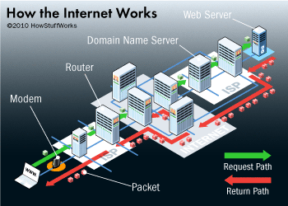
How does the web work ?
The Web (world wide web) is a mean to access all the information on the internet using protocols like HTTP (I.e. methods like POST, GET, DELETE) to send and retrieve data from Clients (I.e. browsers, mobile apps etc.…) via ISP to the different types of servers and data warehouses.

Slide 4
What do you need as a developer ?
As a full stack developer you should have the ability to develop both Client (Front-end) and server (Back-end) software.
To do so you need to at least master :
Web design languages like JavaScript, jQuery, React, Angular, or VueJS.
Scripting language for the server side like PHP, ASP, Python, etc.
Languages to manipulate Databases like SQL, NoSQL, etc.

Slide 5
Why did I choose to learn web development ?
To start with, I enjoy web development. In addition the web is extremely in demand which mean more job opportunities.

Slide 6
Thank you !

